Slide 1
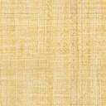



Python Poisoned Wine Puzzle
Shalev Sharabi & Natali Dahary

Slide 2

Problem Introduction
A bad king has a cellar of 1000 bottles of delightful and very expensive wine. A neighboring queen plots to kill the bad king and sends a servant to poison the wine. Fortunately (or say unfortunately) the bad king's guards catch the servant after he has only poisoned one bottle. Alas, the guards don't know which bottle but know that the poison is so strong that even if diluted 100,000 times it would still kill the king. Furthermore, it takes around a month to have an effect. The bad king decides he will buy some slaves to drink the wine. Being a clever bad king, he knows he need only buy 10 slaves and will still be able to drink the rest of the wine (999 bottles) at his anniversary party in 5 weeks time.

Slide 3
Poisoned Wine Puzzle General Overview
The puzzle allows the user to input the amount of jugs (1-1000) and choose which jug number
will be the poisoned wine jug.
In addition, the puzzle allows an option for the computer to decide the number of the poisoned jug.
After that, the slaves who died from the poisoned jug will be displayed according to the binary
number of the poisoned jug chosen.
In the binary number, the positions of the digit 1 will represent the slaves who died and the
positions of the digit 0 represent the slaves who survived.
The purpose of the puzzle is to check which jug is poisoned and which slaves died or survived.
0 1 1 0 1 1 0

Slide 4

Poisoned Wine Puzzle Algorithm
This algorithm initializes a 3-dimensional matrix with dimensions m, n, and p.
The matrix is populated with integers from 1 to n such that each row, column, and diagonal in
each of the m layers contains the numbers 1 to p exactly once.
def __init__(self, n):
self.n = n
self.m = int(math.log(n, 2) + 1)
self.p = int(math.sqrt(int(n // 2) + 1)) + 1
self.matrix = [[[0 for x in range(self.p)]
for y in range(self.p)]
for z in range(self.m)]
self.available_cells = {i: [(r, c) for r in range(self.p) for c in range(self.p)]
for i in range(self.p * 2)}
for i in range(1, n + 1):
sf = bin(i)[2:]
sr = sf[::-1]
t = 0
for j in sr:
if j == "1":
r, c = self.available_cells[t].pop(0)
self.matrix[t][r][c] = i
t += 1

Slide 5
Poisoned Wine Puzzle Solution
We will use binary representation to solve the problem of poisoned wine puzzle.
If we closely observe the pattern to represent all numbers that are less than 2^n we need n bits.
To represent numbers less than 4(2^2), we need 2 bits, to represent numbers less than 8(2^3) we
need 3 bits. And all other numbers less than that power of 2 can be represented with the help of
stated bits.
To represent all numbers less than 512, we will need 9 bits, and for all numbers less than 1024,
we will need 10 bits( and with 10, we can represent all numbers less than or equal to 1023). We
will make all combinations of 0's and 1's in that 10 positions to represent all numbers less than 1024.

Slide 6
Algorithm Analysis
The algorithm initializes a three-dimensional matrix of size m x p x p with m = log_2(n) + 1 and
p = sqrt(n//2 + 1) + 1, where n is the input parameter. It also initializes a dictionary called
available_cells where each key i corresponds to a list of available cells in the matrix at level i.
Then, for each integer i from 1 to n, the algorithm converts i to binary representation and
reverses it. It then iterates over the binary digits of the reversed binary representation and for
each 1 bit, it pops the first available cell from the available_cells dictionary at the corresponding
level t (where t ranges from 0 to m-1) and assigns the value i to that cell in the matrix. Finally, it
increments the t counter.
The time complexity of the algorithm is O(n log(n)) because of the nested loop that iterates over
each binary digit of each integer from 1 to n. The space complexity of the algorithm is O(n log(n))
because of the matrix and available_cells data structures.

Slide 7
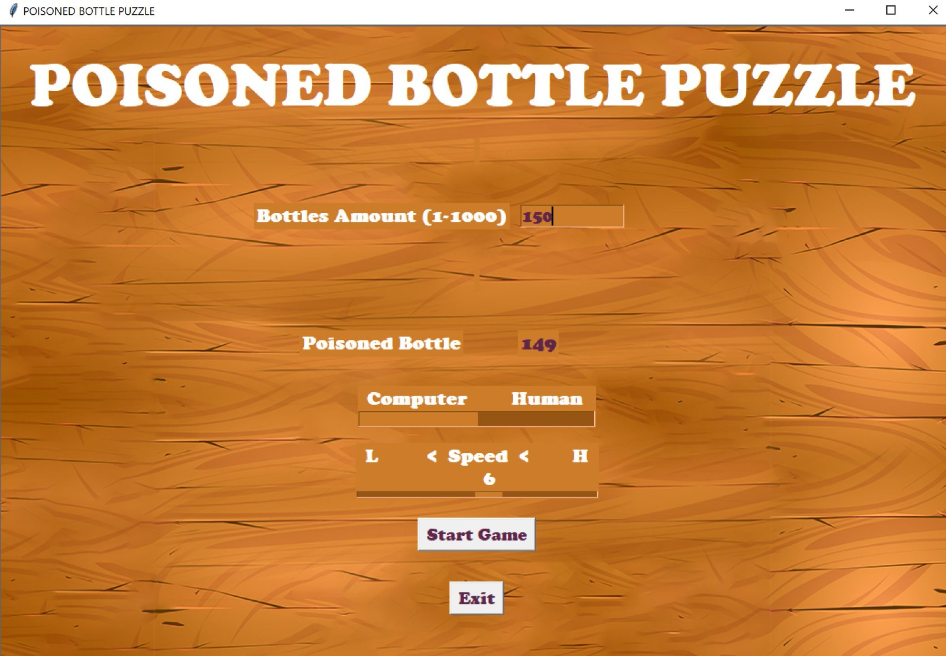
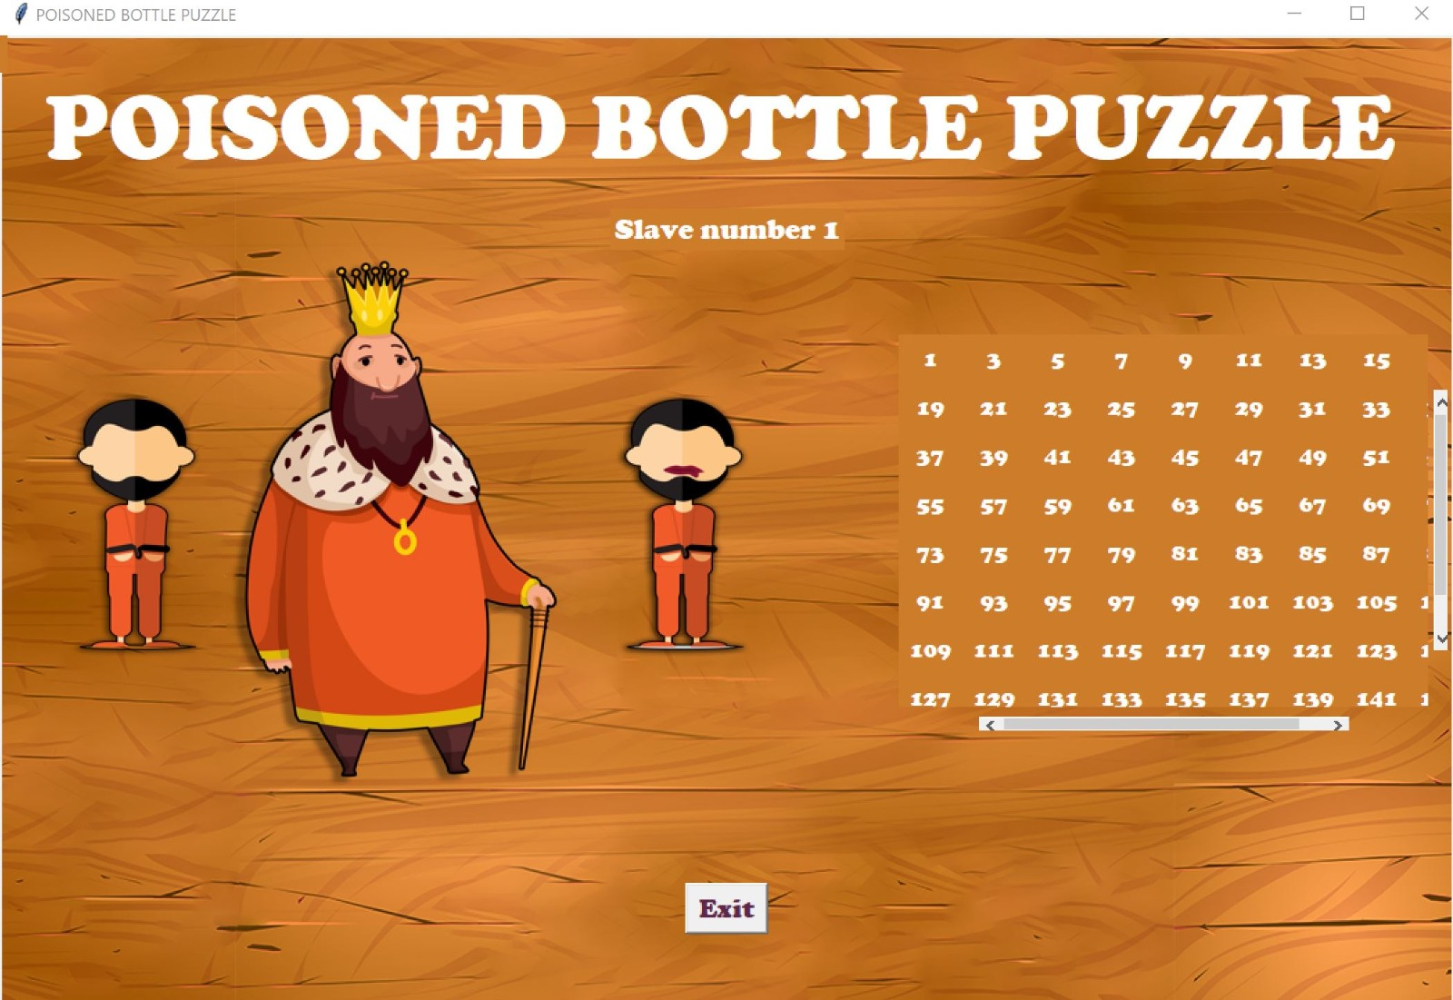
Product Demo

Slide 8
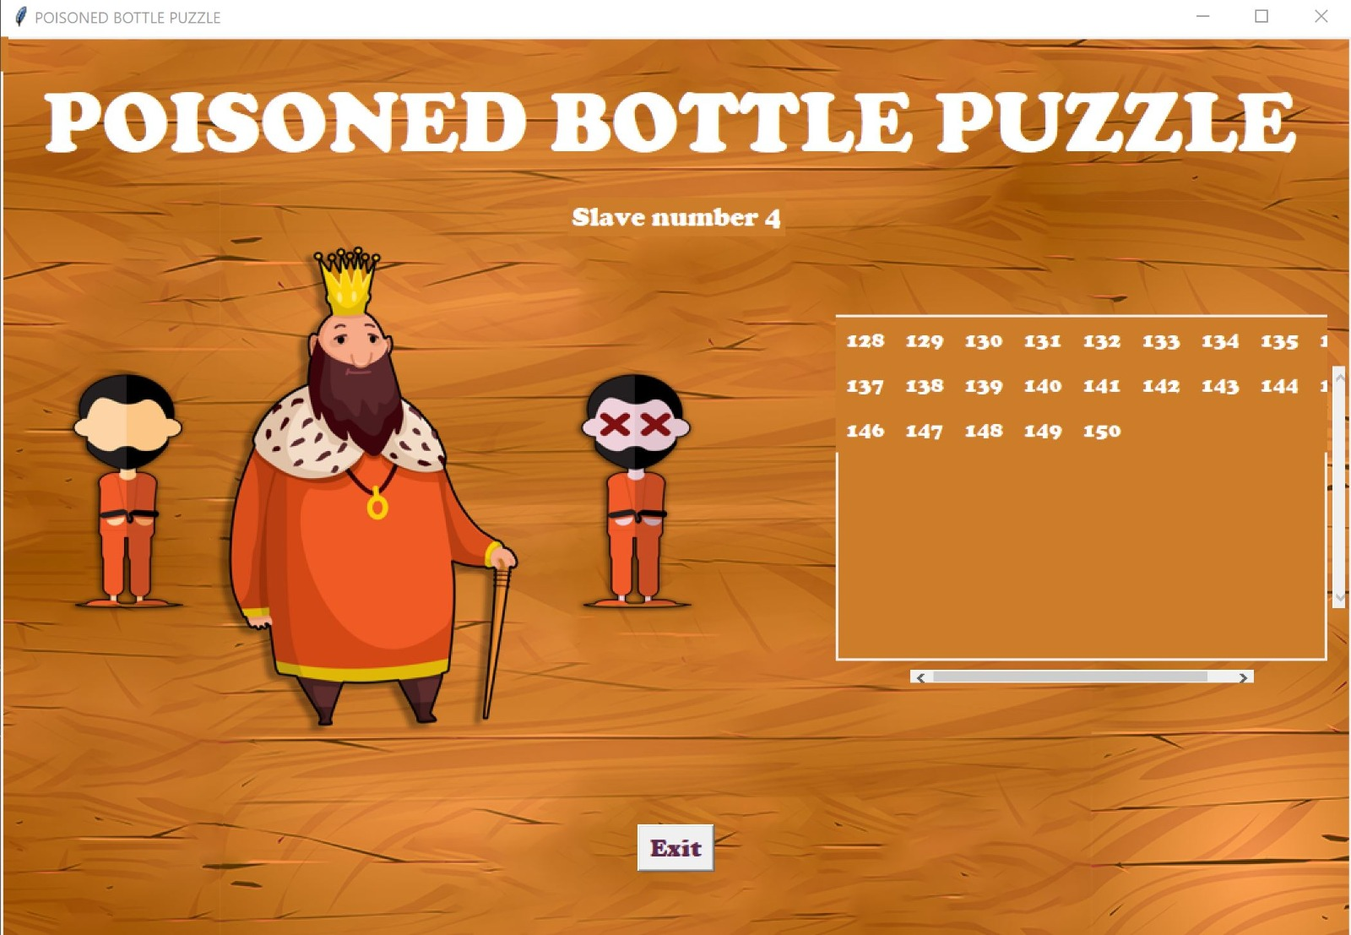
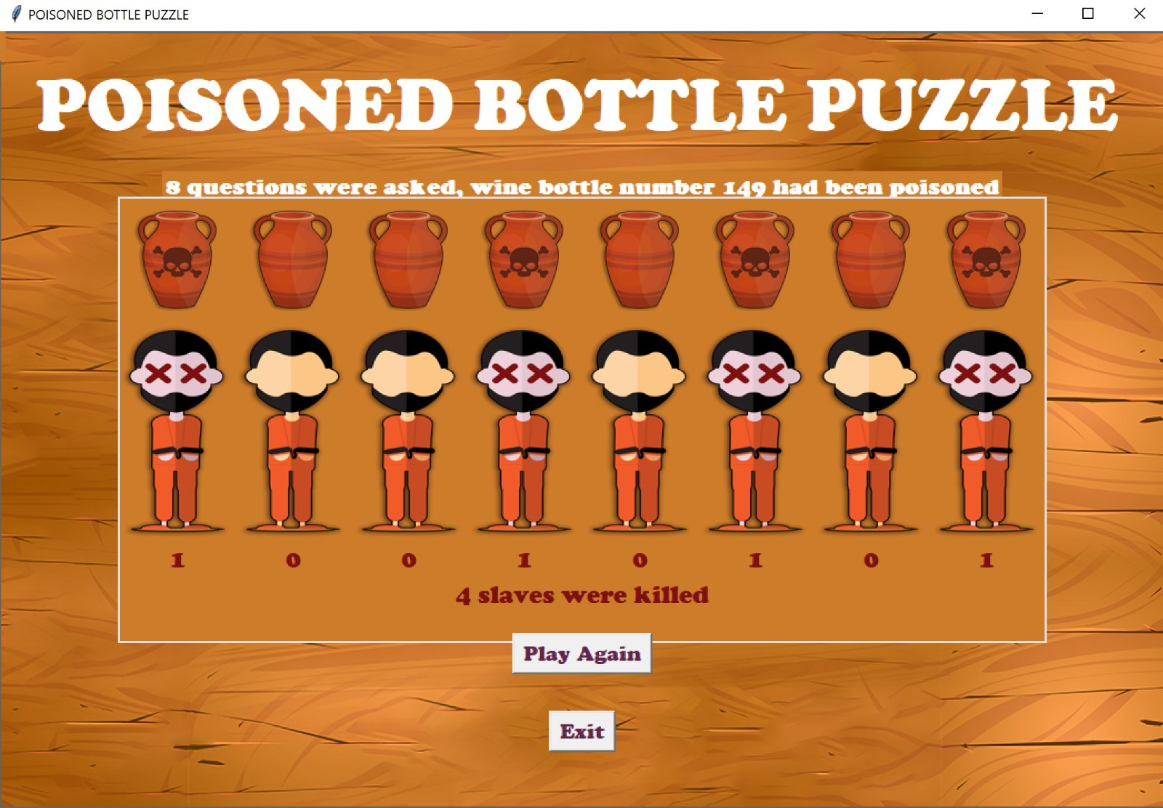
Product Demo

Slide 9
Thanks !
References:
https://www.codingninjas.com/codestudio/library/prisoners-and-poison
https://prepinsta.com/top-100-puzzles/king-wine-bottle-puzzle/
https://ishankdev.medium.com/solving-the-rat-and-the-poison-puzzle-with-an-unconventional-approach-daf37fd28720
https://www.geeksforgeeks.org/puzzle-19-poison-and-rat/
https://mathsmerizing.com/kings-1000-bottles-of-wine-puzzle-method-1/

